Slide 1
QT UI Widgets and Layout_1F
Teleca Chengdu
Author: Johnny Liu
Date: July 19, 2010
Version: 1.0

Slide 2
Have five parts about Qt Widget and Layout
1.QWidget (19 July)
2.QAction(19 July)
3.QMainWindow(19 July)
4.Qdialog (22 July)
5.Qlayout (22 July)
Today is 1, 2, and 3 parts.

Slide 3


1. QWidget
The Chinese meaning of Widget is “窗口部件 ”， it includes buttons, menu, label, all kind of edits, scroll bar and frame, etc.
One widget can contains another widgets.
The QWidget class is the base class of all user interface objects(i.e. QLabel, QPushButton, QSlider, QSpinBox, ect, are inherited from QWidget).
Can be used as top-level window.

Slide 4
QWidget
The widget is the atom of the user interface: it receives mouse, keyboard and other events from the window system, and paints a representation of itself on the screen. Every widget is rectangular, and they are sorted in a Z-order. A widget is clipped by its parent and by the widgets in front of it.
A widget that is not embedded in a parent widget is called a window. Usually, windows have a frame and a title bar, although it is also possible to create windows without such decoration using suitable (window flags). In Qt, QMainWindow and the various subclasses of QDialog are the most common window types.

Slide 5
Top-Level and Child Widgets
A widget without a parent widget is always an independent window (top-level widget). For these widgets, setWindowTitle() and setWindowIcon() set the title bar and icon respectively.
Non-window widgets are child widgets, displayed within their parent widgets. Most widgets in Qt are mainly useful as child widgets. For example, it is possible to display a button as a top-level window, but most people prefer to put their buttons inside other widgets, such as QDialog.

Slide 6
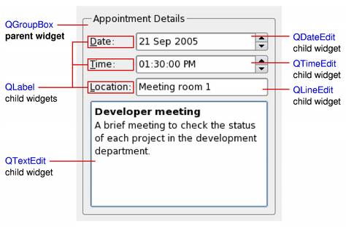
Widget Diagram Sample

Slide 7
Two Samples about Widget
1. The first widget example is in:
\\cnchfs301\projects$\Qt\Examples\Qt Widgets and Layout Samples\widgetTestFirst
2. The second widget example is in:
\\cnchfs301\projects$\Qt\Examples\Qt Widgets and Layout Samples\widgetTestSecond

Slide 8
2. QAction
Action = Item = 项 (E.g. Menu items, Toolbar items, etc.)
The QAction class provides an abstract user interface action that can be inserted into widgets.
In applications many common commands can be invoked via menus, toolbar buttons, and keyboard shortcuts. Since the user expects each command to be performed in the same way, regardless of the user interface used, it is useful to represent each command as an action.
Actions can be added to menus and toolbars, and will automatically keep them in sync. For example, in a word processor, if the user presses a Bold toolbar button, the Bold menu item will automatically be checked.

Slide 9
QAction
Actions can be created as independent objects, but they may also be created during the construction of menus; the QMenu class contains convenience functions for creating actions suitable for use as menu items.
A QAction may contain an icon, menu text, a shortcut, status text, "What's This?" text, and a tooltip. Most of these can be set in the constructor. They can also be set independently with setIcon(), setText(), setIconText(), setShortcut(),setStatusTip(), setWhatsThis(), and setToolTip(). For menu items, it is possible to set an individual font with setFont().
Actions are added to widgets using QWidget::addAction() or QGraphicsWidget::addAction(). Note that an action must be added to a widget before it can be used; this is also true when the shortcut should be global (i.e.,Qt::ApplicationShortcut as Qt::ShortcutContext).

Slide 10
QAction Sample
For example:
QAction *pActOpen;
pActOpen = new QAction(QIcon(":/images/open.png"), tr("&Open..."), this);
pActOpen ->setShortcut(QKeySequence::Open);
pActOpen ->setStatusTip(tr("Open an existing file"));
connect(openAct, SIGNAL(triggered()), this, SLOT(open()));
Qmenu *pMnFile;
pMnFile ->addAction(openAct);
QToolBar *pTbarFile;
pTbarFile ->addAction(openAct);

Slide 11
QAction Notes
Recommend that actions are created as children of the window they are used in. In most cases actions will be children of the application's main window(Especially in Menu and ToolBar)
Once a QAction has been created it should be added to the relevant menu and toolbar, then connected to the slot which will perform the action.

Slide 12
3. QMainWindow
A main window provides a framework for building an application's user interface. Qt has QMainWindow and its related classes for main window management. QMainWindow has its own layout to which you can add QToolBars, QDockWidgets, a QMenuBar, and a QStatusBar. The layout has a center area that can be occupied by any kind of widget.
You can see the diagram of the QMainWindow layout on next page:

Slide 13
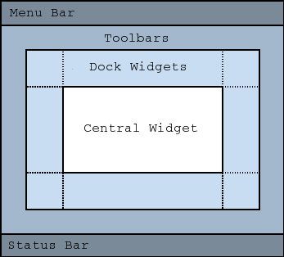
QMainWindow Layout Daigram

Slide 14
QMainWindow
Note:
Creating a main window without a central widget is not supported.
You must have a central widget even if it is just a placeholder.

Slide 15
Creating Main Window Components
A central widget will typically be a standard Qt widget such as a QTextEdit or a QGraphicsView. Custom widgets can also be used for advanced applications. You set the central widget with setCentralWidget().
Main windows have either a single (SDI) or multiple (MDI) document interface. You create MDI applications in Qt by using a QMdiArea as the central widget.

Slide 16
Creating Menus
Qt implements menus in QMenu and QMainWindow keeps them in a QMenuBar. QAction are added to the menus, which display them as menu items.
You can add new menus to the main window's menu bar by calling menuBar(), which returns the QMenuBar for the window, and then add a menu with addMenu() or addAction().
QMainWindow comes with a default menu bar, but you can also set one yourself with setMenuBar(). If you wish to implement a custom menu bar (i.e., not use the QMenuBar widget), you can set it with setMenuWidget().

Slide 17
Creating Menus
An example of how to create menus follows:
void MainWindow::createMenus()
{
QAction *pActNew = new QAction(tr(“&New”), this);
Qmenu *pMnFile = menuBar()->addMenu(tr("&File"));
pMnFile ->addAction(pActNew);
}
Notes:
In those codes, menuBar() function creates and returns an empty menu bar if the menu bar does not exist.
If we want to create parent-less menu bar, use below way:
QMenuBar *menuBar = new QMenuBar(0);

Slide 18
Creating Menus
Notes:
1. The createPopupMenu() function creates popup menus when the main window receives context menu events. The default Implementation generates a menu with the checkable actions from the dock widgets and toolbars.
2. You can reimplementcreatePopupMenu() for a custom menu.

Slide 19
Creating Toolbars
Toolbars are implemented in the QToolBar class. You can add a toolbar to a main window with addToolBar().
You control the initial position of toolbars by assigning them to a specific Qt::ToolBarArea. You can split an area by inserting a toolbar break - think of this as a line break in text editing - with addToolBarBreak() or insertToolBarBreak(). You can also restrict placement by the user with QToolBar::setAllowedAreas() and QToolBar::setMoveable().
The size of toolbar icons can be retrieved with iconSize(). The sizes are platform dependent; you can set a fixed size with setIconSize(). You can alter the appearance of all tool buttons in the toolbars with setToolButtonStyle().

Slide 20
Creating Toolbars
One example of toolbar creation follows:
void MainWindow::createToolBars()
{
QAction *pActNew = new QAction(tr(“&New”), this);
QToolBar *pTbarFile = addToolBar(tr("File"));
pTbarFile ->addAction(pActNew );
}

Slide 21
Creating Dock Widgets
Dock widgets are implemented in the QDockWidget class. A dock widget is a window that can be docked into the main window. You can add dock widgets to a main window with addDockWidget().
There are four dock widget areas as given by the Qt::DockWidgetArea enum: left, right, top, and bottom. You can specify which dock widget area that should occupy the corners where the areas overlap with setCorner(). By default each area can only contain one row (vertical or horizontal) of dock widgets, but if you enable nesting with setDockNestingEnabled(), dock widgets can be added in either direction.
Two dock widgets may also be stacked on top of each other. A QTabBar is then used to select which of the widgets that should be displayed.

Slide 22
Creating Dock Widgets
One example of how to create and add dock widgets to a main window:
QWidget *pWgtContents;
QDockWidget *pDwgtShow = new QDockWidget(tr("Dock Widget"), this);
pDwgtShow ->setAllowedAreas(Qt::LeftDockWidgetArea | Qt::RightDockWidgetArea);
pDwgtShow ->setWidget(pWgtContents);
addDockWidget(Qt::LeftDockWidgetArea, pDwgtShow);

Slide 23
The Status Bar
You can set a status bar with setStatusBar(), but one is created the first time statusBar() (which returns the main window's status bar) is called.
See QStatusBar for information on how to use it.

Slide 24
The difference between QWidget and QMainWindow
QWidget can be used as top-level window or not uesed as top-level window. But QMainWindow just can be used as top-level window.
Qwidget include frame, label, button, edits, scroll bar, ect. But QMainWindow is just include frame, we need add all kinds of widgets on it according to our necessary.
QMainWindow have menu, toolbar, statusbar, but Qwidget haven’t those. E.g. In Symbian platform, QMainWindow have two menus itself(Option and Exit), but QWidget don’t have menu at all(only has Exit). The illustration is on next page:

Slide 25
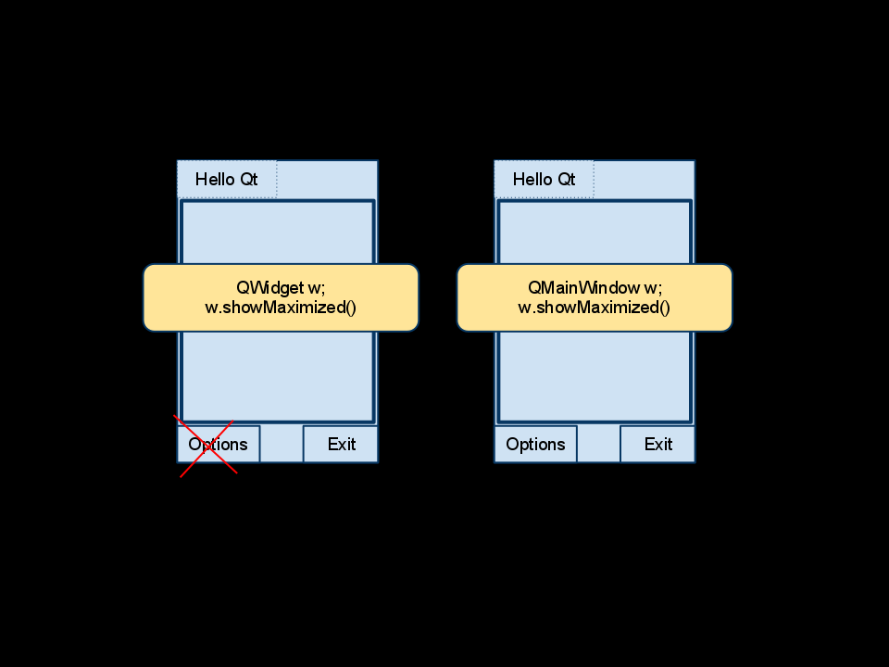
The difference between QWidget and QMainWindow Diagram Sample

Slide 26
One Sample about QMainWindow
The example of QMainWindow is in:
\\cnchfs301\projects$\Qt\Examples\Qt Widgets and Layout Samples\mainwindowTest

Slide 27
Practice
Imitate the three sample in \\cnchfs301\projects$\Qt\Examples\Qt Widgets and Layout Samples create a Qwidget and a QMainWindow projects.
Aim/Demands:
1.Practice to use Qt Creator/Designer/Assistant.
2. Practice to use Coding Convention name variables.
3. Practice to use simple singal/slot mechanism.
4. Practice to use layout for your UI designer.
Please send your codes to my email inbox as below:
Johnny.Liu@teleca.com

Slide 28
Thank you!

